Slide 1
The Implicit Relational Assessment Procedure (IRAP) as a Measure of Obsessive Beliefs Related to Disgust
Emma Nicholson, Angela McCourt & Dermot Barnes-Holmes

Slide 2
Introduction
Obsessions are caused by the misinterpretation of intrusive thoughts or private experiences which cause negative affect which in turn drives compulsions to alleviate this distress (Rachman, 1997)
OCD is very much a problem of cognitive process over cognitive content (Twohig, 2009)
A lack of psychological flexibility is associated with OCD symptoms in adults and children (Abramowitz, Lackey, & Wheaton, 2009)
The OCCWG has identified six cognitive obsessive belief domains, or rules, of OCD 1) excessive responsibility; 2) overestimation of threat; 3) perfectionism; 4) intolerance of uncertainty; 5) over-importance of thoughts and 6) need to control thoughts (OCCWG, 2001)
Notes:
ACT theories say that the person avoiding the doorknob are doing so to avoid the negative affect of doing so and CBT is saying that that these negative interpretations explain why this negative affect occurs in the first place

Slide 3
Introduction
Teachman (2006) argued that these cognitive domains provide a useful platform on which to establish the interpretation processes at work in disgust
Existing evidence delineating the relationship between disgust responding along with contamination fear and the obsessive belief domains has been inconsistent
Moretz and McKay (2008) found that a predisposition to become disgusted was related to obsessive beliefs
David et al. (2009) found that disgust sensitivity failed to remain a significant predictor of OCD symptoms when controlling for obsessive beliefs (as measured by the OBQ)

Slide 4
Introduction
No evidence has attempted to test Teachman’s (2006) supposition by specifically measuring obsessive beliefs in response to disgust-eliciting stimuli
Few studies have attempted to measure how the individual appraises or responds to disgust
Cognitive theories of OCD posit that intrusive thoughts carry no valence until they are positively, negatively or neutrally appraised (Salkovskis, 1985; Rachman, 1997)
Previous research with the IRAP has shown that its not the propensity to experience disgust it’s the tendency to respond negatively to the thoughts that arise due to disgust to cause problematic behaviours such as avoidance (Nicholson & Barnes-Holmes, 2012)

Slide 5
The Present Study
Behavioural measures of OCD are necessary in order to circumvent the pitfalls of working exclusively with self-report measures (Twohig, Hayes & Masuda, 2006;Wheaton et al. 2010)
IRAP may offer a novel way of measuring these processes relevant to OCD at the implicit level
The current study implemented an IRAP designed to measure these obsessive beliefs or rules at the implicit level, specifically in response to disgust-eliciting stimuli
It was hypothesised that those who score highly on the Obsessive Beliefs questionnaire (OBQ) would produce greater negative implicit appraisal of the disgusting stimuli
Preliminary research to determine whether these domains can be measured with the IRAP

Slide 6
Method
Participants (N = 27) were undergraduate students from NUI Maynooth (Mean age: 26.4)
IRAP measuring obsessive beliefs in response to disgust eliciting stimuli
Questionnaires: State Anxiety Inventory, Padua Inventory, Obsessive-Compulsive Inventory and the Obsessive Belief Questionnaire

Slide 7
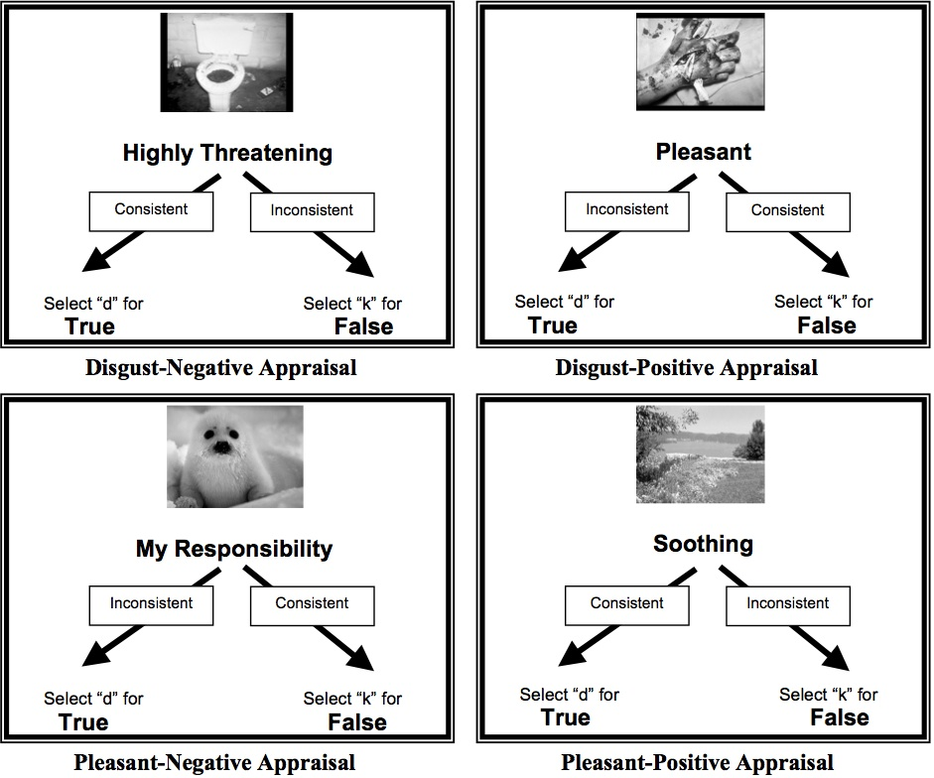
Method

Slide 8
Results
All trial-types were significant from zero (p’s ≤ .0001)

Slide 9
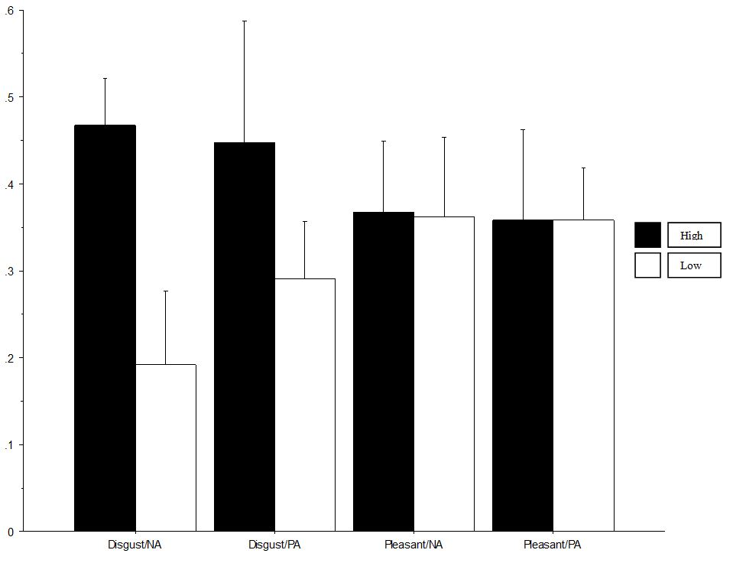
No main effect of group (p = .1); no interaction (p = .4)
p=.2
p=.03
Mixed Repeated Measures ANOVA with Obsessive-Belief Level as the between-group measure
Notes:
Mean D-IRAP score (.459) for the high group is significant from zero (p < .0001). Mean D-IRAP score (.191) for the low group was also significant from zero (p < .04).

Slide 10
Correlation Analysis
 | Disgust/NA | OBQ | R/T | P/C | I/CT | Padua | OCI | STAI
Disgust/NA | - | .48* | .56** | .43* | .18 | .34# | .17 | .16
* p < .05 ** p < .01 # p <. 07
Table 1. Pearson Correlation Matrix of Disgust-Negative Appraisal trial-type, OBQ, OCI-R, PI, and STAI

Slide 11
Correlation Analysis
 | Contamination | Dressing/ Grooming | Checking | Obsessional Thoughts of Harm | Obsessional Impulses to Harm
Disgust/ NA | .03 | -.01 | .50** | .40* | .25
* p < .05 ** p < .01
Table 2. Pearson Correlation Matrix of Disgust-Negative Appraisal trial-type and subscales of the Padua Inventory

Slide 12
Results
OBQ
Step 1: Anxiety
Step 2: Disgust/NA
R² = .189, p < .01
R² change = .144, p < .01
Figure 1. Hierarchical Multiple Regression predicting overall score on the OBQ with anxiety entered at step 1 and the IRAP trial-type Disgust-Negative Appraisal entered at step 2

Slide 13
Results
Responsibility/ Threat
Step 1: Anxiety
Step 2: Disgust/NA
R² = .178, p < .01
R² change = .225, p < .01
Figure 2. Hierarchical Multiple Regression predicting Responsibility/Threat subscale of the OBQ, with anxiety entered at step 1 and the IRAP trial-type Disgust-Negative Appraisal entered at step 2

Slide 14
Results
Perfectionism/ Uncertainty
Step 1: Anxiety
Step 2: Disgust/NA
R² = .084
R² change = .127, p < .05
Figure 3. Hierarchical Multiple Regression predicting Perfectionism/Uncertainty subscale of the OBQ, with anxiety entered at step 1 and the IRAP trial-type Disgust-Negative Appraisal entered at step 2

Slide 15
Results
Checking Compulsions
Step 1: Anxiety
Step 2: Disgust/NA
R² = .186,
p < .01
R² change = .168, p < .01
Figure 4. Hierarchical Multiple Regression predicting Checking subscale of the Padua, with anxiety entered at step 1 and the IRAP trial-type Disgust-Negative Appraisal entered at step 2

Slide 16
Discussion
Firstly, the results showed that BIRRs are relevant to obsessive beliefs of OCD in relation to disgust
The D-IRAP score can be used to predict scores on the OBQ as a whole, and on two of the individual subscales: excessive responsibility/overestimation of threat and perfectionism/intolerance of uncertainty.
Interestingly, the D-IRAP score was also predictive of OC tendencies that it did not directly intend to measure i.e., checking compulsions
Critically, these effects were not influenced by anxiety

Slide 17
Discussion
There is mixed evidence for the relationship between OC symptoms beliefs and experiential avoidance (Abramowitz et al., 2009)
Future research could assess the relationship between experiential avoidance and obsessive beliefs at the implicit level

Slide 18
Questions?
Emma.Nicholson@nuim.ie

